Slide 1

ICN-IP Coexistence Solutions
MHD Nazeer Kawas , Lisa Facciolo

Slide 2
Replacement of the existing architecture Internet Protocol (IP): - challenging task involve multiple parties coordination such ISPs.. -indefinite time to update the hardware and software, unexpected complications. -Coexistence between old and new architecture which is the purpose of our presentation.
The current Internet architecture:
- was designed for small research community 3 decades ago.
- now more than 23 billion devices , this misalignment in usage led to explore new solutions
- first issue is the availability of unique IP, another one is the type of traffic (HTTP),now 86% only video
traffic
From security aspect this design doesn’t guarantee origin auth, data integrity , data confidentiality

Slide 3
What is ICN? - new network communication module which might replace the current one (host-centric to information-centric networking). the ICN paradigm was first introduced in the TRIAD project in 2001. - instead of using IPs and DNS , they can send request only specifying only content names. - This decoupling between request sending and content transferring introduces several benefits: reduction of latency and network load due to in-network caching, inherent content integrity and better support for mobility due to name-based routing. - ICN is suitable networking model for emerging technologies, such as (IoT) and 5G. (in-network caching feature)

Slide 4
Why ICN? - 5G-ICN provides a single protocol able to handle mobility and security, instead of using a diverse set of IP-based Third Generation Partnership Project (3GPP) - Additionally, the receiver-driven communication in ICN allows IoT-receivers to ask for data without revealing their location information, thus being privacy supporting. - it provides a unifying platform with the same layer-3 Application Programming Interfaces (APIs) to integrate heterogeneous radios and wired interfaces in the same network - it converges services like computing, storage, and networking over a single platform

Slide 5
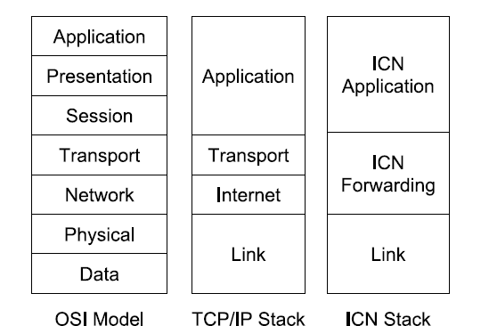
Comparison Between IP-Based and ICN-Based Internet Architectures - ICN Application: the protocols of this layer address content names instead of hosts locations. - ICN Forwarding: equivalent to the TCP/IP Network layer but source and destination IP addresses are removed from the network packets and only the addressed content name is declared. - Link: this layer introduces a mapping between MAC addresses and content names.
Routing: the packets sent by a requester contain only the full name of the content and no IP addresses
NDN and CCN architectures : longest-prefix match
- DONA: name-based routing
- PURSUIT: flat name scheme

Slide 6
- Comparison Between IP-Based and ICN-Based Internet Architectures - Name Resolution: differs according to the forwarding approach in case of name-based routing, the requester specifies a content by providing its full name // which is the same name PURSUIT or NetInf, there is always a dedicated node in the network, which is responsible for the mapping between publishers and subscribers - Storing: in ICN, caching is fundamental and almost any node is able to cache contents and to serve the corresponding requests. - Traffic Management: the congestion control refers to the prevention of the routers from becoming overflowed and it’s provided by ACK messages in TCP/IP. In ICN some architectures, such as DONA, still rely on the existing transport protocols. other ICN solutions NDN, do not provide the Transport layer functionalities and, instead, delegate them to the application itself.

Slide 7
- Benefits of ICN-Based Architectures - Scalable and Cost-Efficient Content Distribution: the inherent ICN support for caching at the network layer, together with the receiver-driven mechanism, the support for mobility and the multicast routing - Mobility and Multihoming: ICN supports the mobility at the network layer by decoupling time and space between request resolution and content transfer it has tow features for mobility 1- receiver-driven communication model 2- connectionless request/response communication model and perfect approach to DTN //transport session - Security: content integrity and source authentication, For a content-centric architecture, where contents can be located and provided in any point of the network, and not only by the original content producer, the security is particularly significant. - Emerging Technologies: (SDN), Network Functions Virtualization (NFV), Content Delivery Network (CDN)

Slide 8
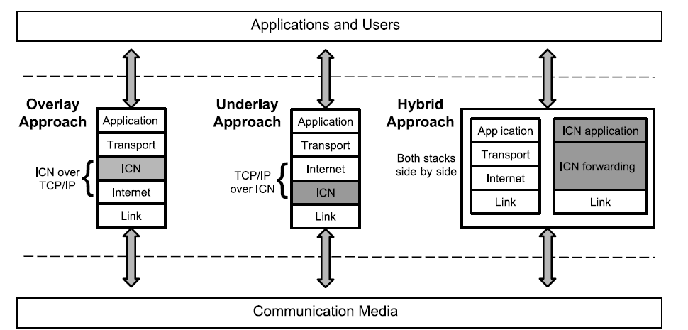
- COEXISTENCE ARCHITECTURES: FEATURES AND EVALUATION PARAMETERS

Slide 9
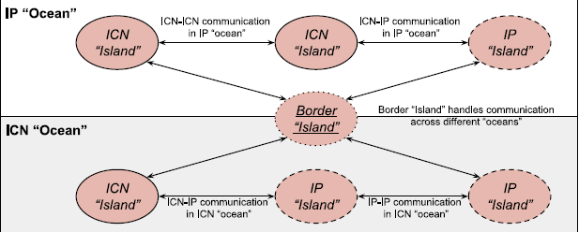
- COEXISTENCE ARCHITECTURES: FEATURES AND EVALUATION PARAMETERS - 1) Deployment Approaches: overlay in case of ICN running on top of the IP protocol IP “ocean”, underlay in case of ICN running under the IP protocol IP “islands”, and hybrid in case of a coexistence of both IP and ICN protocols the hybrid approach claims the coexistence of both ICN and IP, by adopting dual stack nodes able to handle the semantics of both IP and ICN packets a dual stack node can use various options to infer content names from an IP packet, such as performing deep packet inspection in the payload or looking into the content name in the IP option header. - 2) Deployment Scenarios: Each deployment scenario involves two “islands”, which run either the same networking architecture or two separate ones, surrounded by an ICN or an IP “ocean”. • ICN-ICN communication in IP “ocean”. • ICN-IP communication in IP “ocean”. • ICN-IP communication in ICN “ocean”. • IP-IP communication in ICN “ocean”. • Border Island - communication between different “islands” in separate “oceans”.

Slide 10
- COEXISTENCE Requirements - 1) Addressed Coexistence Requirements: In a coexistence scenario,the different networks might generate conflicts ex. ICN doesn’t provide transport functionalties provided by the TCP - Forwarding: How network forwarding devices should be able to handle packet with different routing identifiers. - Storage : the network devices should support in-network caching to serve the content request and reduce bandwidth consumption. - Security: the network devices should preserve the security policies from the source network to the destination such as authenticating the digital signatures of content objects for content-based security - Management the network devices should support management-related operations such as trafficshaping/ engineering, load-balancing, and explicit path steering.

Slide 11
- deployment of a coexistence architecture - real scenarios challenges: As evaluation parameters, the following challenges arises. - Access control - Scalability - Dynamic network management - Latency - Traffic management

Slide 12
- CLASSIFICATION OF THE COEXISTENCE ARCHITECTURES:

